Slide 1

Basics of Neural Network Programming
Binary Classification
deeplearning.ai

Slide 2
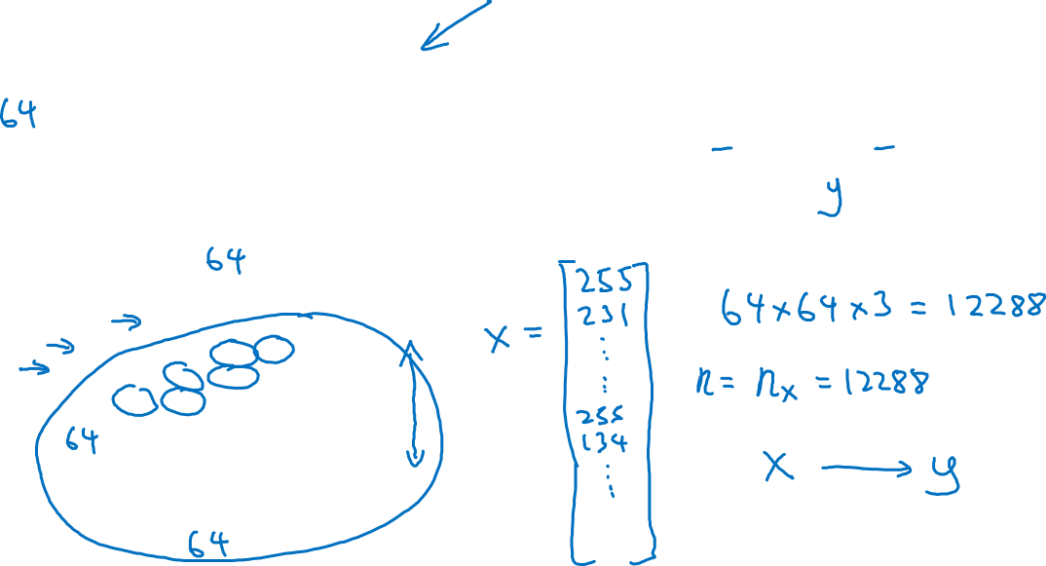
Binary Classification
1 (cat) vs 0 (non cat)
Blue
Green
Red

Slide 3
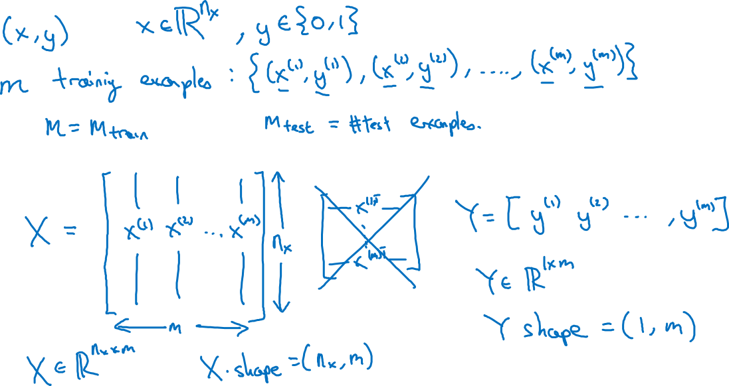
Notation

Slide 4
Basics of Neural Network Programming
Logistic Regression
deeplearning.ai

Slide 5
Logistic Regression

Slide 6
Basics of Neural Network Programming
Logistic Regression
cost function
deeplearning.ai

Slide 7
Logistic Regression cost function
$\hat{y} = σ\left(w^{T}x +b\right)$, where $σ\left(z \right)=\frac{1}{1+e^{−z}}$
Given $\left\{{(x}^{(1)},y^{(1)}\text{)}\text{,}\text{…}\text{,}{(x}^{(m)},y^{(m)}\text{)}\right\},$want ${\hat{y}}^{(i)}≈y^{\left(i\right)}$.
Loss (error) function:

Slide 8
Basics of Neural Network Programming
Gradient Descent
deeplearning.ai

Slide 9
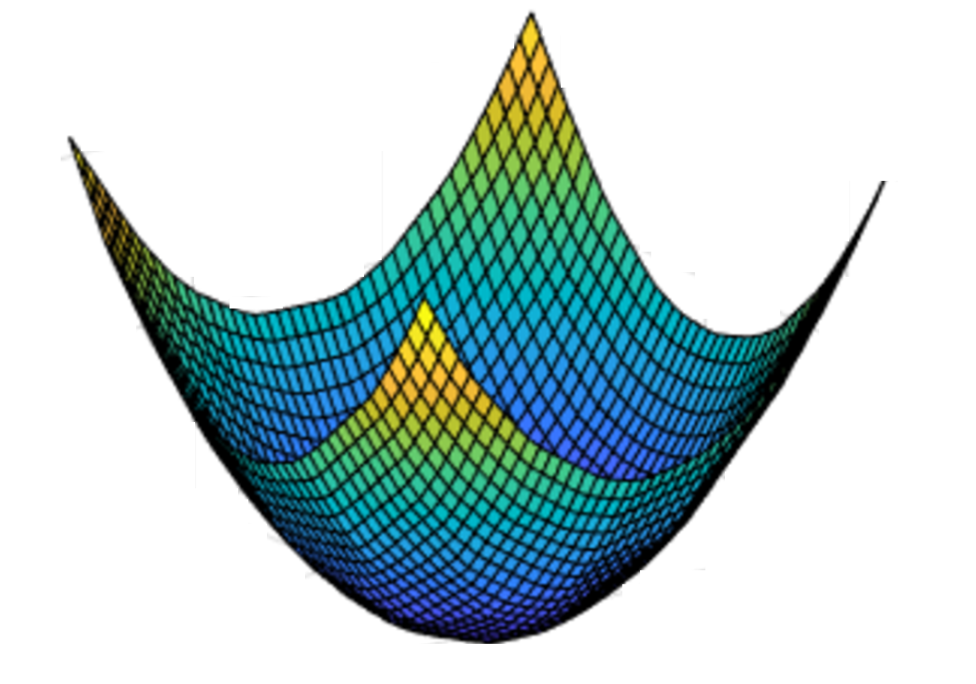
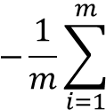


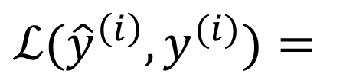
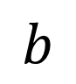

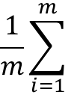
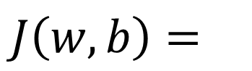


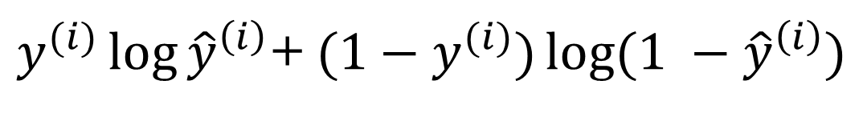

Gradient Descent
Recap: $\hat{y}= σ\left(w^{T}x+b\right)$, $σ\left(z\right)=\frac{1}{1+e^{−z}}$
$$\frac{1}{m}\sum_{i=1}^{m}{ }$$
$ℒ({\hat{y}}^{\left(i\right)},y^{(i)})$ $=$
$$−\frac{1}{m}\sum_{i=1}^{m}{ }$$
$$J\left(w,b\right)=$$
$y^{(i)}\log{{\hat{y}}^{\left(i\right)}}$+ $({1−y}^{(i)})\log{(1 −{\hat{y}}^{\left(i\right)})}$
Want to find $w,b$ that minimize $J\left(w,b\right)$
$$J\left(w,b\right)$$
$$b$$
$$w$$

Slide 10

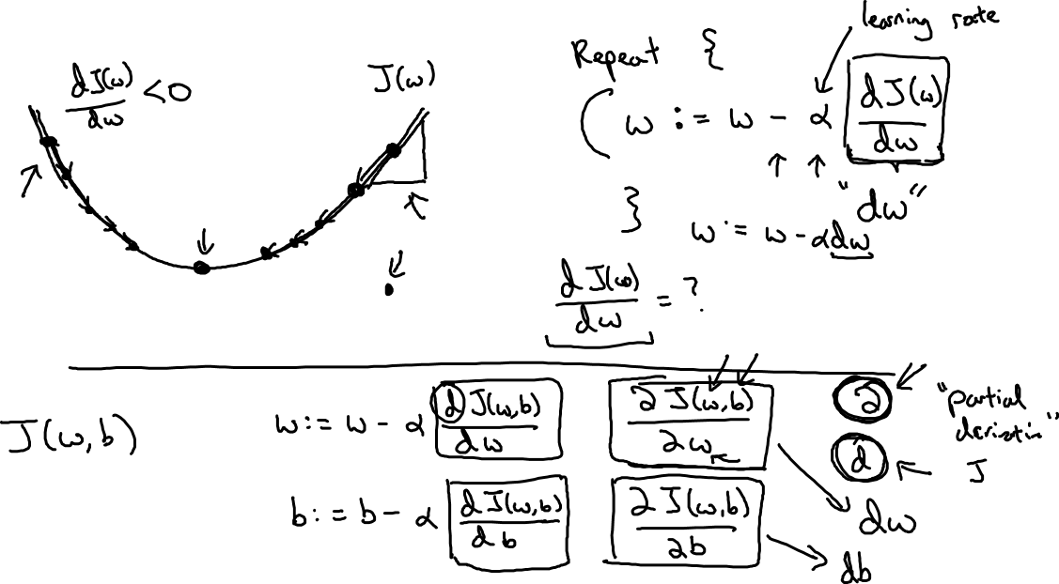
Gradient Descent
$$w$$

Slide 11
Basics of Neural Network Programming
Derivatives
deeplearning.ai

Slide 12
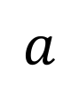
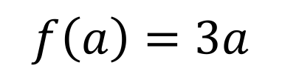
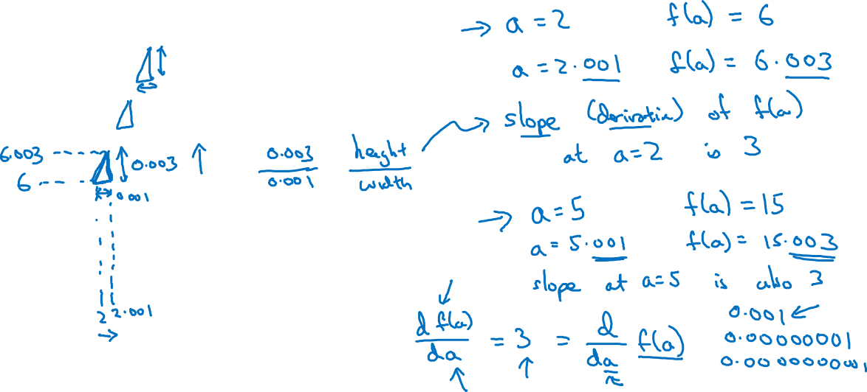
Intuition about derivatives
$$f\left(a\right)=3a$$
$$a$$

Slide 13
Basics of Neural Network Programming
More derivatives examples
deeplearning.ai

Slide 14
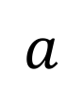
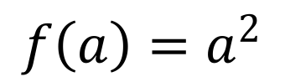
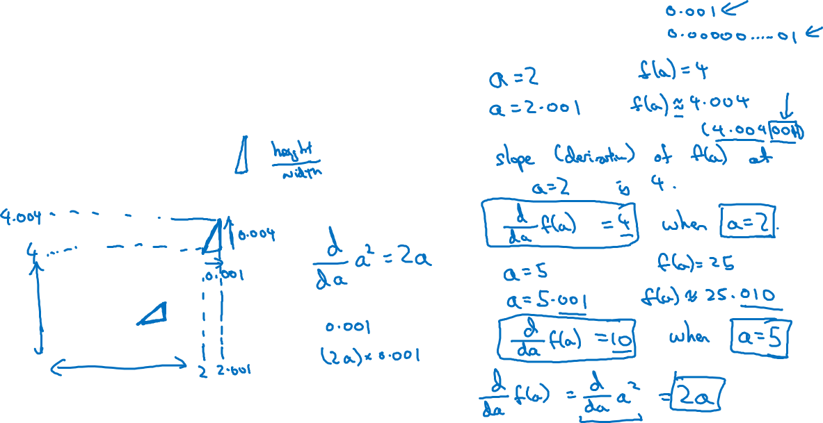
Intuition about derivatives
$$f\left(a\right)=a^{2}$$
$$a$$

Slide 15
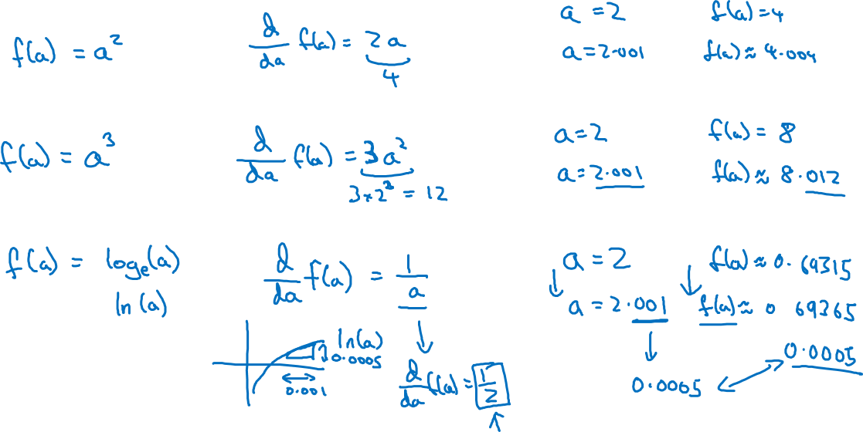
More derivative examples

Slide 16
Basics of Neural Network Programming
Computation Graph
deeplearning.ai

Slide 17
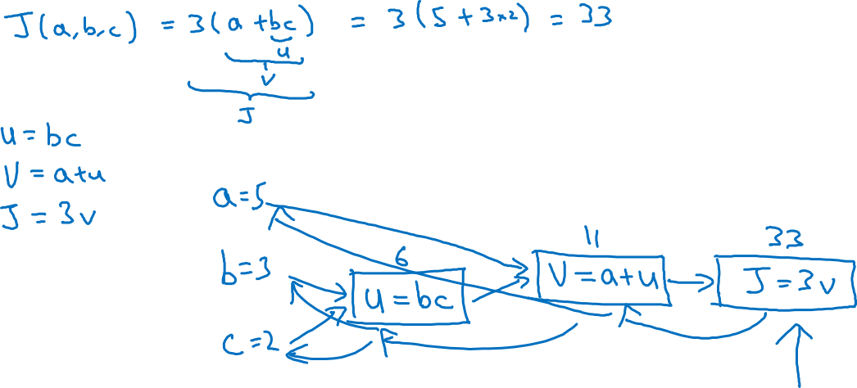
Computation Graph

Slide 18
Basics of Neural Network Programming
Derivatives with a Computation Graph
deeplearning.ai

Slide 19
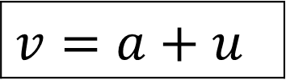
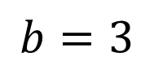
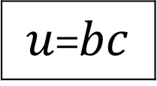
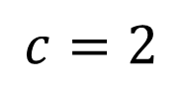
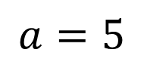
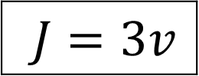
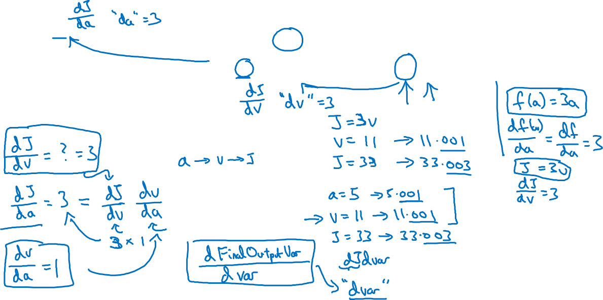
Computing derivatives
$$a=5$$
11
33
$$b=3$$
6
$$v=a+u$$
$J=3v$
$u$=$bc$
$$c=2$$

Slide 20
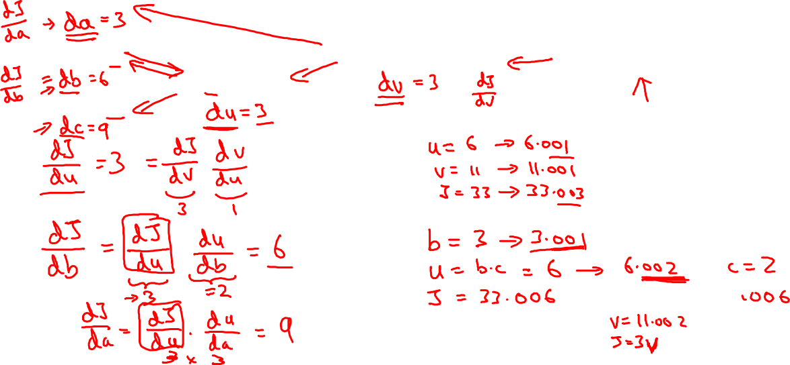
Computing derivatives
$$a=5$$
11
33
$$b=3$$
6
$$v=a+u$$
$J=3v$
$u$=$bc$
$$c=2$$

Slide 21
Basics of Neural Network Programming
Logistic Regression
Gradient descent
deeplearning.ai

Slide 22
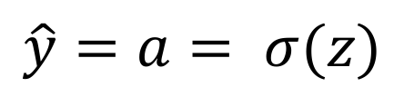
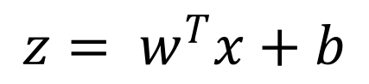
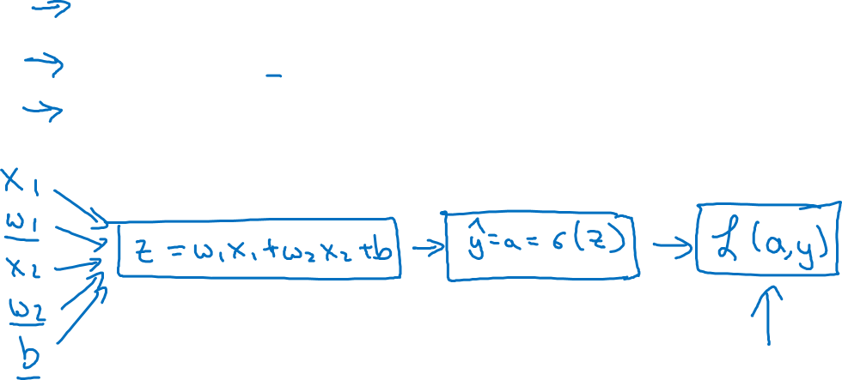

Logistic regression recap
$$z= w^{T}x+b$$
$$\hat{y}=a= σ(z)$$
$$ℒ\left(a,y\right)=−(y\log{(a)+(1−y)\log{(1−a))}}$$

Slide 23
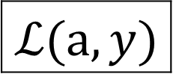
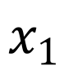
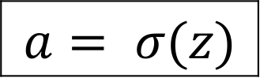
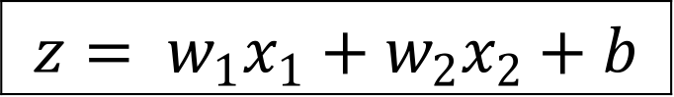
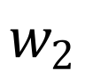
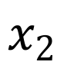
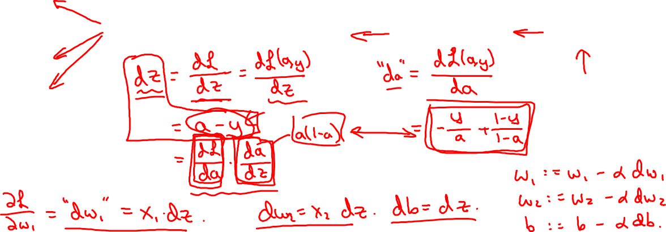
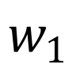
Logistic regression derivatives
$$x_{1}$$
$$w_{1}$$
$$x_{2}$$
$$z= w_{1}x_{1}+w_{2}x_{2}+b$$
$$a= σ(z)$$
$$ℒ(a,y)$$
$$w_{2}$$
b

Slide 24
Basics of Neural Network Programming
Gradient descent
on m examples
deeplearning.ai

Slide 25
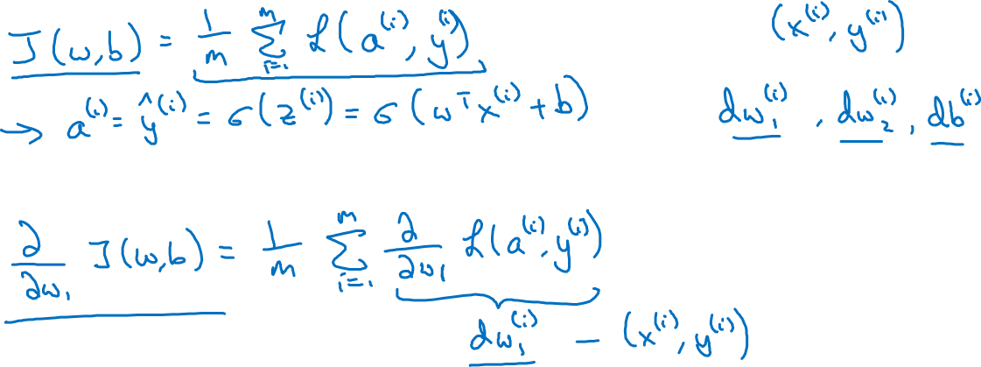
Logistic regression on m examples

Slide 26
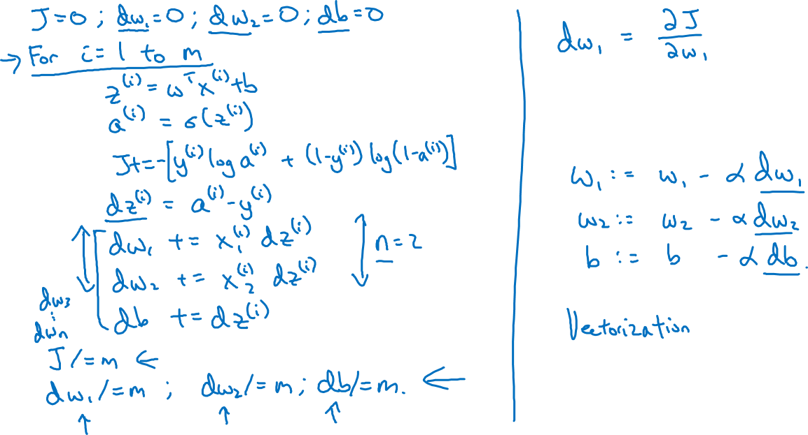
Logistic regression on m examples

